Slide 1
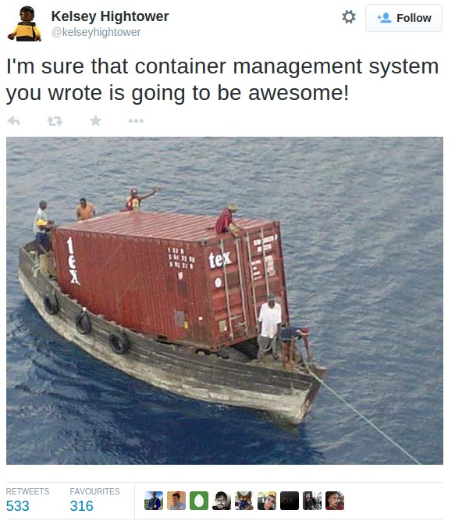

Slide 2
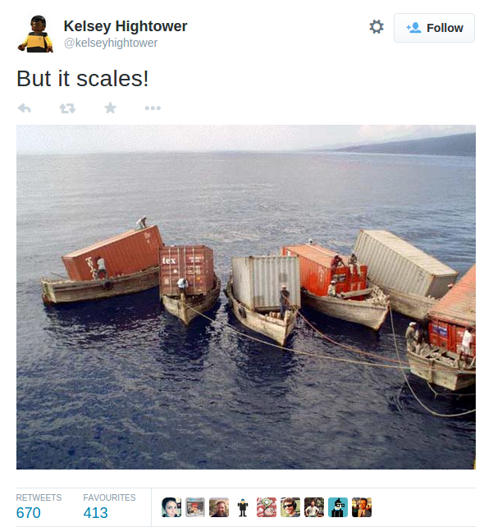

Slide 3
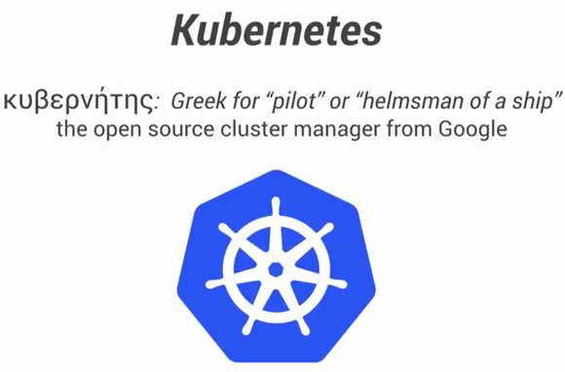


Slide 4
Pods: Co-located, ephemeral groups of containers. Public IP address. Arbitrary labels.
Replication Controller: Manages lifecycle of a selection of Pods
Services: Provides stable entry to selection of ephemeral Pods.

Slide 5
Service
select: name=web
env=prd
Replication Contoller
Template: container:web
replicas: 3
selector: name=web
env=prd
Pod
Name: web
container: web
label: env=prd
Replication Controller
Template: container:db
replicas: 1
selector: name=db
env=prd
Service
select: name=db
env=prd
Pod
Name: db
container: db
label: env=prd

